Slide 1


Martim Ramos
21 October 2026
GitHub: https://github.com/martimramos/ibmds

Slide 2

Executive Summary
Summary of methodologies
Summary of all results
Data collection: SpaceX REST API + Wikipedia web scraping → 90 Falcon 9 launches (2010–2020)
Data wrangling: landing outcome → binary label Class (1 = landed); one-hot encoding → 80 features
EDA with visualization (Seaborn) and SQL (10 queries on SQLite)
Interactive visual analytics: Folium maps and a Plotly Dash dashboard
Predictive analysis: Logistic Regression, SVM, Decision Tree, KNN tuned with GridSearchCV (cv = 10)
EDA: 66.7% of launches landed; success rose from 0% (2010–13) to 90% (2019) and grows with flight number
SQL: 4 launch sites; NASA (CRS) payload 45,596 kg; first ground-pad landing 22 Dec 2015; 100 of 101 missions succeeded
Folium: all sites are coastal; KSC LC-39A has the best success ratio; CCAFS SLC-40 is 0.49 km from the coast
Dash: KSC LC-39A has 41.7% of all successes and a 76.9% success ratio; 2,000–4,000 kg payloads land most often
Classification: LogReg, SVM and KNN reach 83.3% test accuracy; SVM is best (84.8% CV), Decision Tree 72.2%
GitHub repository (all notebooks + Dash app): https://github.com/martimramos/ibmds

Slide 3
Introduction
Project background and context
Problems we want to find answers to
SpaceX advertises Falcon 9 launches at about $62 M; other providers charge upwards of $165 M
Most of the saving comes from landing and reusing the first stage
If we can predict whether the first stage will land, we can estimate the cost of a launch, which is useful for a competitor such as Space Y bidding against SpaceX
1
Which factors (site, payload, orbit, booster, flight history) drive a successful landing?
2
How has landing success changed over time?
3
Where are the launch sites, and what surrounds them?
4
Can a classifier predict the landing outcome, and how reliably?

Slide 4
Data Collection Methodology: SpaceX API and Web Scraping
SpaceX REST API
Web scraping (Wikipedia)
GET /v4/launches/past
requests.get(fixed wiki revision)
json_normalize → launch table
BeautifulSoup(response.text)
Look up rockets, launchpads, payloads, cores
find_all('table') → column names
Filter Falcon 9 (90), impute payload mean
Parse each <tr> into launch_dict
dataset_part_1.csv
spacex_web_scraped.csv
Single-core, single-payload launches up to 13 Nov 2020; 26 missing LandingPad values kept
“List of Falcon 9 and Falcon Heavy launches”: flight, date, booster, site, payload, mass, orbit, customer, outcome
GitHub lab URL: https://github.com/martimramos/ibmds/blob/main/01_spacex_data_collection_api.ipynb
GitHub lab URL: https://github.com/martimramos/ibmds/blob/main/02_spacex_webscraping.ipynb

Slide 5
Data Wrangling Methodology
Checked missing values and data types per column
Counted launches per site, per orbit and per landing outcome
Outcome = mission result + landing type (ASDS = drone ship, RTLS = ground pad, Ocean)
Defined bad_outcomes = landing ‘False’ or ‘None’ → Class 0; otherwise Class 1
Overall success rate: 66.7% → saved as dataset_part_2.csv
For modelling: one-hot encoded Orbit, LaunchSite, LandingPad, Serial → 80 numeric features (dataset_part_3.csv)
Outcome | Launches | Class
True ASDS | 41 | 1
None None | 19 | 0
True RTLS | 14 | 1
False ASDS | 6 | 0
True Ocean | 5 | 1
False Ocean | 2 | 0
None ASDS | 2 | 0
False RTLS | 1 | 0
GitHub lab URL: https://github.com/martimramos/ibmds/blob/main/03_spacex_data_wrangling.ipynb

Slide 6
EDA Methodology: Data Visualization and SQL
Charts plotted, and why
SQL queries performed (SQLite, %sql)
Chart | Purpose
Flight Number vs. Launch Site (scatter) | experience effect per site
Payload vs. Launch Site (scatter) | payload limits per site
Success rate by Orbit (bar) | compare mission profiles
Flight Number vs. Orbit (scatter) | experience effect per orbit
Payload vs. Orbit (scatter) | payload effect per orbit
Yearly success rate (line) | trend over time
Distinct launch site names
5 records where site begins with ‘CCA’
Total payload mass for NASA (CRS)
Average payload mass of F9 v1.1
First successful ground-pad landing date
Drone-ship successes with 4,000–6,000 kg payload
Count of mission outcomes
Boosters with the maximum payload (sub-query)
2015 drone-ship failures (month, booster, site)
Rank landing outcomes 2010-06-04 to 2017-03-20
GitHub lab URL: https://github.com/martimramos/ibmds/blob/main/05_spacex_eda_dataviz.ipynb
GitHub lab URL: https://github.com/martimramos/ibmds/blob/main/04_spacex_eda_sql.ipynb

Slide 7
Interactive Visual Analytics Methodology: Folium and Plotly Dash
Folium map objects
Plotly Dash components
Circle + Marker with DivIcon label for each launch site, to locate all sites
MarkerCluster of all 56 launch records, to group launches per site
Green / red Icons for landed / failed, to read site success at a glance
MousePosition to read coordinates of coast, roads, rail and cities
PolyLine + distance label (Haversine), to measure proximity to infrastructure
Dropdown (All Sites or one site): drives both charts
Pie chart: share of successes by site, or success vs. failure for one site, to compare and drill down
Range slider (payload 0–10,000 kg), to isolate payload bands
Scatter plot: payload vs. outcome coloured by booster version, to spot payload and booster effects
Two callbacks connect the inputs to the charts
GitHub lab URL: https://github.com/martimramos/ibmds/blob/main/06_spacex_launch_site_location_folium.ipynb
GitHub lab URL: https://github.com/martimramos/ibmds/blob/main/07_spacex_dash_app.py

Slide 8
Predictive Analysis Methodology (Classification)
Load data
Y = Class, X = 80 features
Scale
StandardScaler
Split 80/20
72 train / 18 test
GridSearchCV
cv = 10, 4 models
Evaluate
accuracy, confusion matrix
Improve & pick
repeated CV, best model
Model | Hyper-parameter grid | Best parameters
Logistic Regression | C ∈ {0.01, 0.1, 1}, l2, lbfgs | C = 1
SVM | kernel ∈ {linear, rbf, poly, sigmoid}, C, γ ∈ logspace(-3, 3, 5) | sigmoid, C = 1, γ = 0.032
Decision Tree | gini/entropy, best/random, depth 2–18, leaf, split | gini, depth 10
KNN | k = 1–10, algorithm, p ∈ {1, 2} | k = 6, p = 1 (Manhattan)
Built 4 models, evaluated each on the held-out test set, improved the choice by re-scoring with 20× repeated 5-fold CV, and selected the model with the best accuracy.
GitHub lab URL: https://github.com/martimramos/ibmds/blob/main/08_spacex_machine_learning_prediction.ipynb

Slide 9
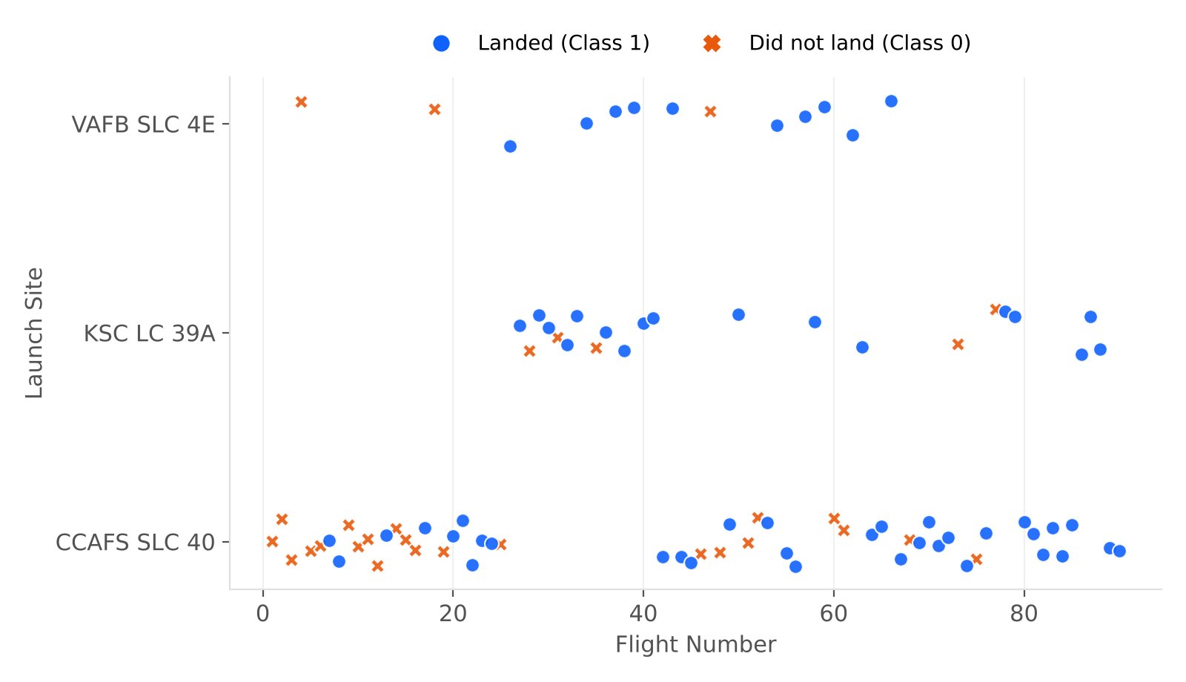
EDA with Visualization: Flight Number vs. Launch Site
Scatter plot of flight number vs. launch site, coloured by outcome
CCAFS SLC 40 hosts 55 of 90 launches, including most early failures
VAFB SLC 4E and KSC LC 39A came online after ~flight 20
At every site later flights are mostly successes
Key insight Landing success grows with flight number at all sites; the site effect is partly an experience effect.

Slide 10
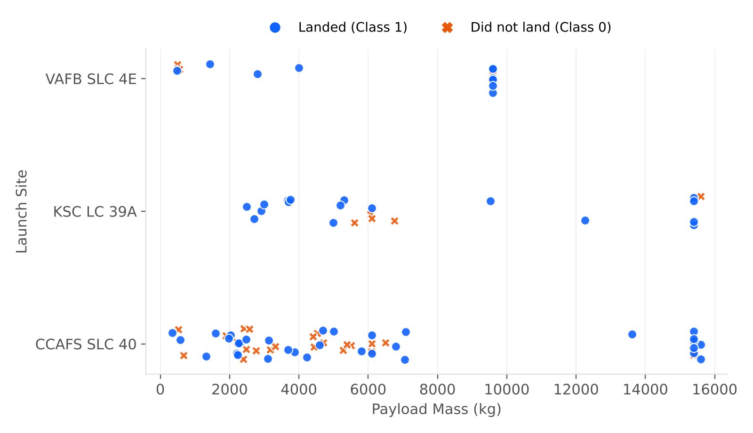
EDA with Visualization: Payload vs. Launch Site
Scatter plot of payload mass vs. launch site
VAFB SLC 4E launched no payload above 10,000 kg
Heavy payloads (> 12,000 kg) flew from CCAFS and KSC and nearly all landed
Key insight Site success rates: KSC 77%, VAFB 77%, CCAFS 60%. Payload alone does not explain failures.

Slide 11
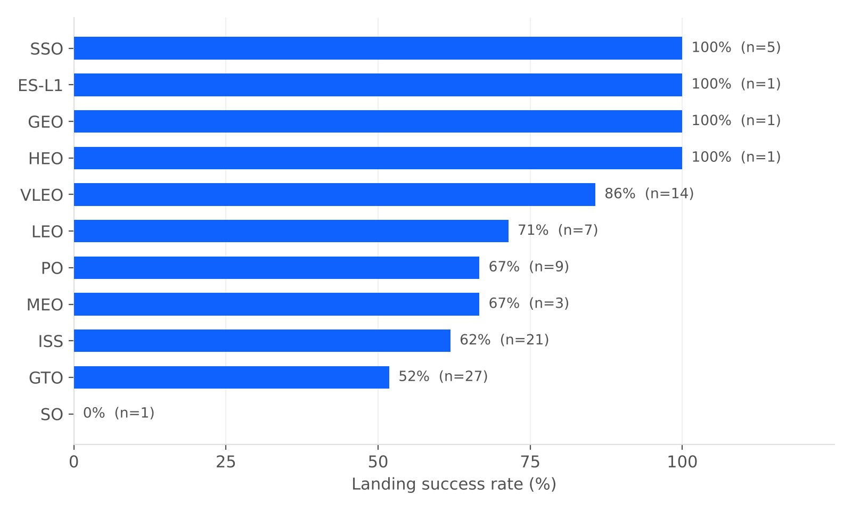
EDA with Visualization: Success Rate vs. Orbit Type
Bar chart of landing success rate for each orbit
ES-L1, GEO, HEO, SSO: 100% (n ≤ 5)
VLEO 86%, LEO 71%, PO 67%, ISS 62%, GTO 52%
SO: 0% (one launch)
Key insight GTO (27 launches) and ISS (21) are the real hard cases; the 100% orbits have very few launches.

Slide 12
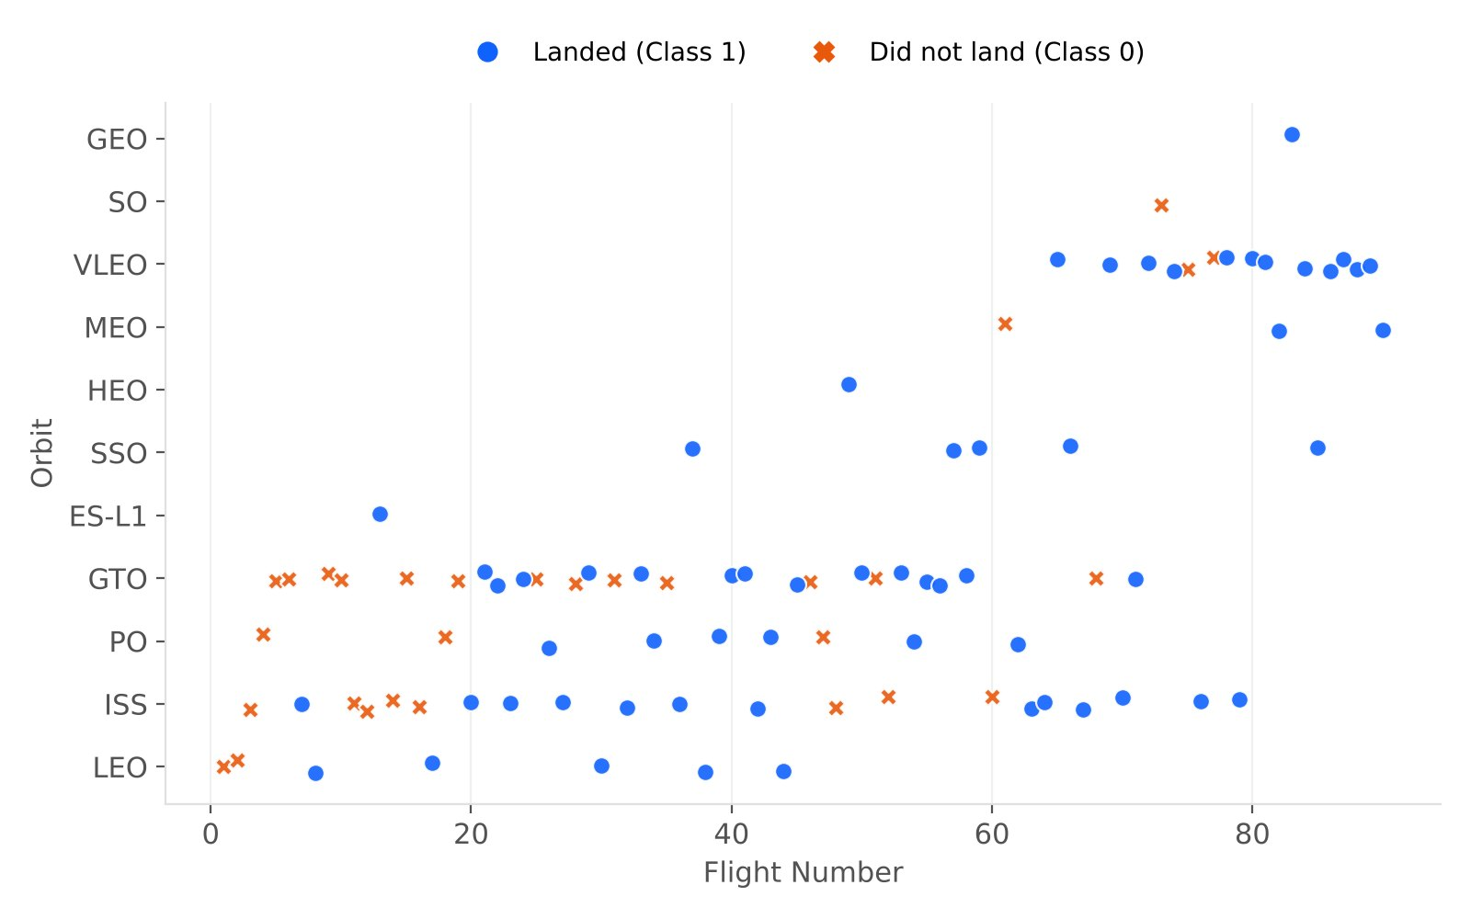
EDA with Visualization: Flight Number vs. Orbit Type
Scatter plot of flight number vs. orbit
LEO: success appears related to the number of flights
GTO: no clear relationship with flight number
VLEO starts after flight ~60 and mostly lands
Key insight Newer orbit types (VLEO, SSO) were flown once SpaceX was experienced, which inflates their success rates.

Slide 13
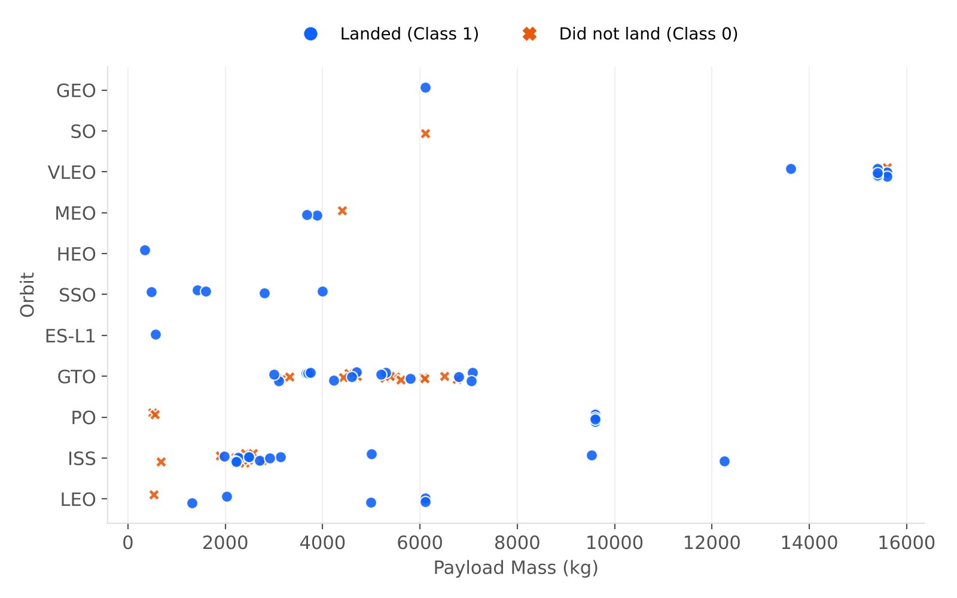
EDA with Visualization: Payload vs. Orbit Type
Scatter plot of payload mass vs. orbit
Heavy payloads land more often for Polar, LEO and ISS orbits
GTO mixes successes and failures at every payload level
VLEO carries the heaviest payloads (15,600 kg)
Key insight Payload interacts with orbit: heavy is fine for LEO-type missions, while GTO stays uncertain at any mass.

Slide 14
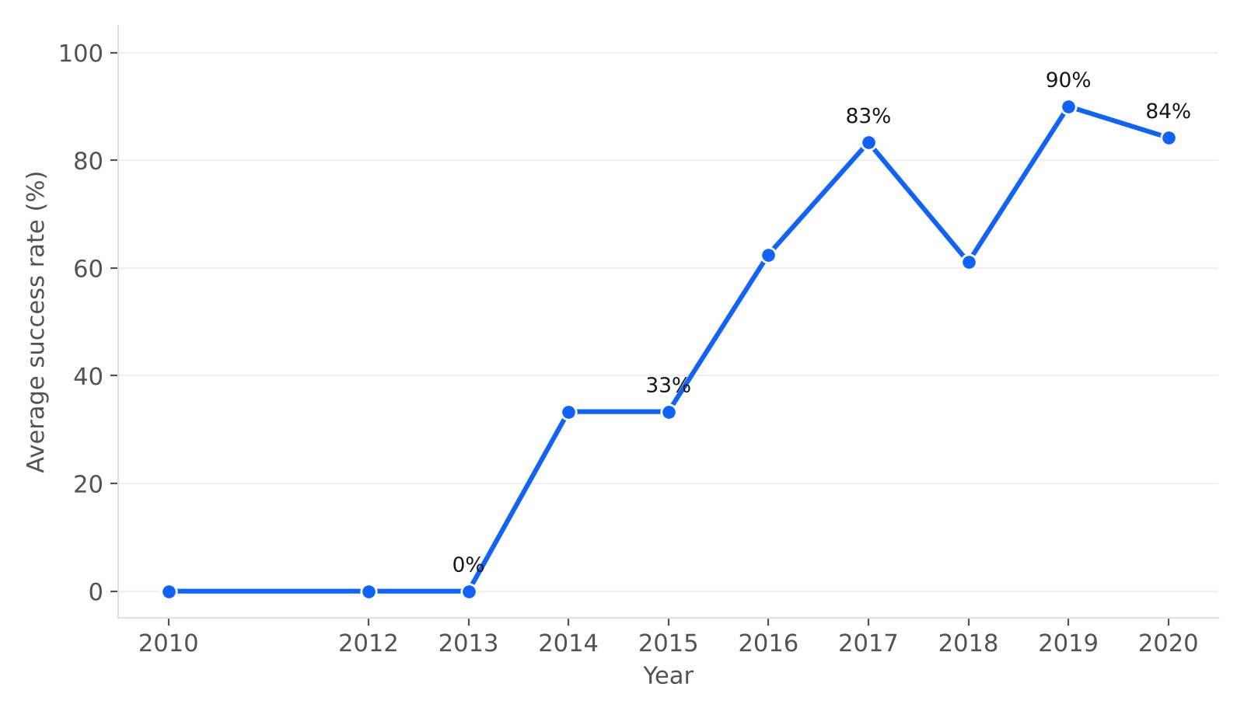
EDA with Visualization: Launch Success Yearly Trend
Line chart of the average success rate per year
2010–2013: 0%
2014–2015: 33%; 2016: 62%
2017: 83%, dip in 2018 (61%)
2019: 90%; 2020: 84%
Key insight The success rate has kept increasing since 2013, which is consistent with a strong learning curve.

Slide 15
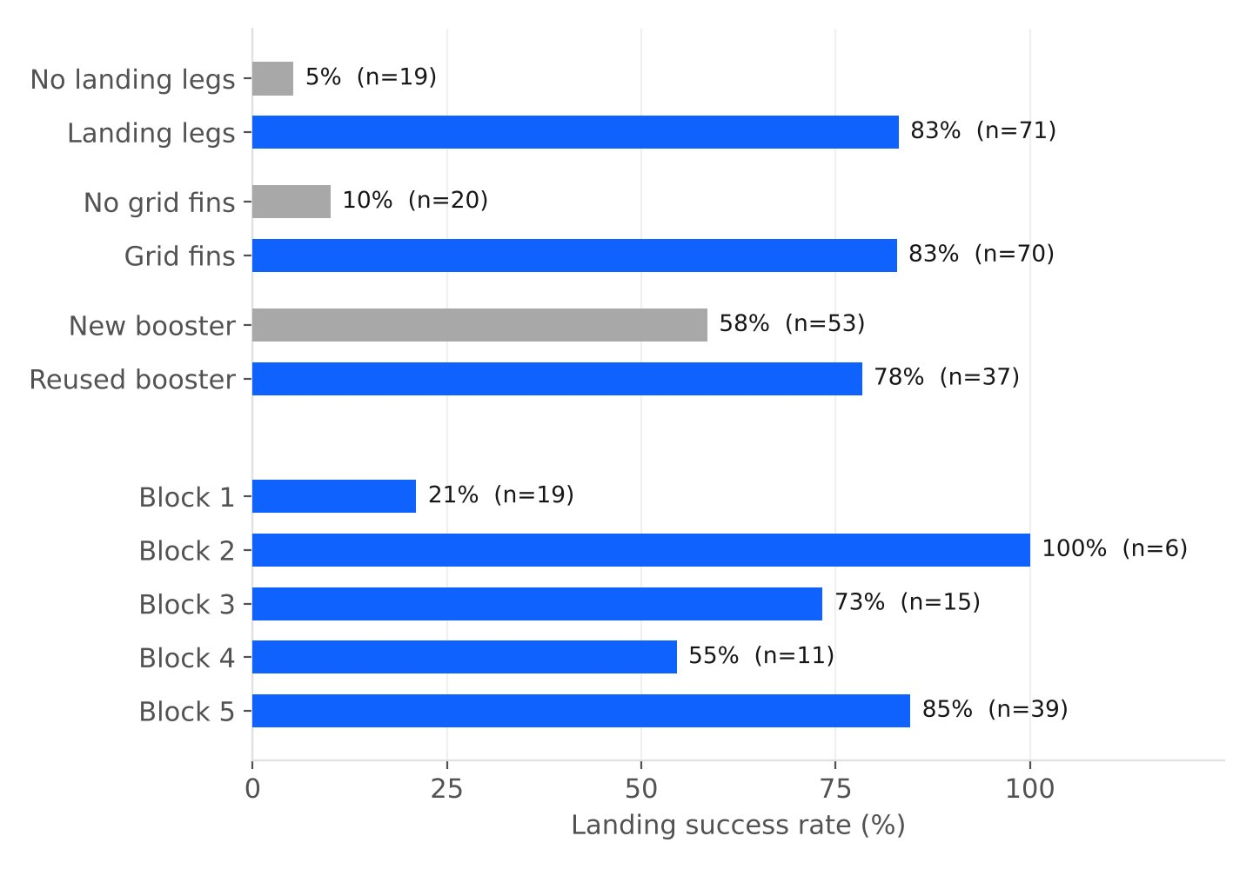
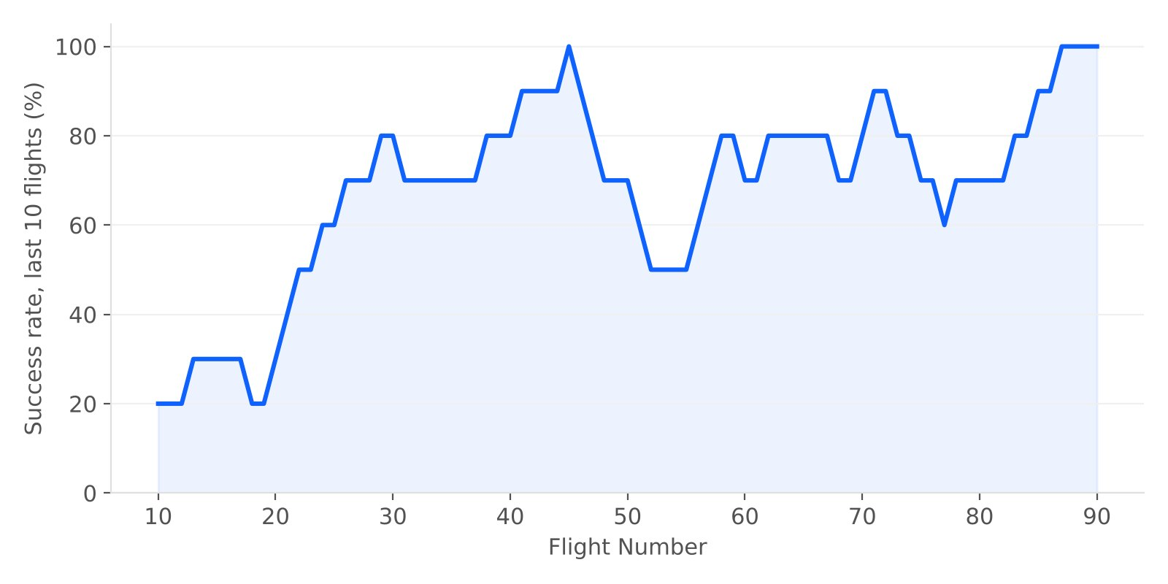
Innovative Insights: Hardware and the Learning Curve
10-flight rolling success rate: flights 1–30 43%, 31–60 73%, 61–90 83%. It first reached 80% at flight 29 and ended at 100%
Launches without legs / grid fins were not landing attempts. Among the 71 real attempts, 83% landed; reused boosters 78% vs. new 58%; Block 5 85%
Key insight For a competitor, the key question is “will SpaceX attempt a landing?”. When it does, it usually succeeds, and recent flights matter most.

Slide 16
EDA with SQL: Launch Sites and ‘CCA’ Records
Q1 Find the names of the unique launch sites
SELECT DISTINCT Launch_Site
FROM SPACEXTABLE
Launch_Site
CCAFS LC-40
VAFB SLC-4E
KSC LC-39A
CCAFS SLC-40
Q2 Find 5 records where launch sites begin with ‘CCA’
SELECT * FROM SPACEXTABLE
WHERE Launch_Site LIKE 'CCA%'
LIMIT 5
Result (5 rows) shown below: all are F9 v1.0 flights from CCAFS LC-40, 2010–2013.
Date | Booster | Site | Payload | kg | Landing_Outcome
2010-06-04 | F9 v1.0 B0003 | CCAFS LC-40 | Dragon Spacecraft Qualification Unit | 0 | Failure (parachute)
2010-12-08 | F9 v1.0 B0004 | CCAFS LC-40 | Dragon demo flight C1, two CubeSats, b | 0 | Failure (parachute)
2012-05-22 | F9 v1.0 B0005 | CCAFS LC-40 | Dragon demo flight C2 | 525 | No attempt
2012-10-08 | F9 v1.0 B0006 | CCAFS LC-40 | SpaceX CRS-1 | 500 | No attempt
2013-03-01 | F9 v1.0 B0007 | CCAFS LC-40 | SpaceX CRS-2 | 677 | No attempt
Key insight 4 launch sites (3 Florida, 1 California). The first CCA records are early Dragon demo and NASA CRS flights.

Slide 17
EDA with SQL: Payload Totals, Averages and First Landing
Q3 Total payload mass carried by boosters for NASA (CRS)
SELECT SUM(PAYLOAD_MASS__KG_) AS Total_Payload_kg
FROM SPACEXTABLE
WHERE Customer = 'NASA (CRS)'
45,596 kg
NASA's CRS resupply missions: a key recurring customer
Q4 Average payload mass carried by booster version F9 v1.1
SELECT AVG(PAYLOAD_MASS__KG_) AS Avg_Payload_kg
FROM SPACEXTABLE
WHERE Booster_Version = 'F9 v1.1'
2,928.4 kg
(2,534.7 kg if LIKE 'F9 v1.1%' includes all v1.1 serials)
Q5 Date of the first successful landing on a ground pad
SELECT MIN(Date) AS First_Ground_Pad_Success
FROM SPACEXTABLE
WHERE Landing_Outcome = 'Success (ground pad)'
2015-12-22
ORBCOMM-2 (RTLS), 5 years after the first Falcon 9 flight
Q6 Boosters with drone-ship success and 4,000 < payload < 6,000 kg
SELECT Booster_Version
FROM SPACEXTABLE
WHERE Landing_Outcome = 'Success (drone ship)'
AND PAYLOAD_MASS__KG_ > 4000
AND PAYLOAD_MASS__KG_ < 6000
4 boosters
F9 FT B1022, F9 FT B1026, F9 FT B1021.2, F9 FT B1031.2
All Falcon 9 FT; two (.2) were reused boosters

Slide 18
EDA with SQL: Mission Outcomes, Max Payload and 2015 Failures
Q7 Total number of successful and failure mission outcomes
SELECT Mission_Outcome, COUNT(*) AS Total
FROM SPACEXTABLE
GROUP BY Mission_Outcome
Mission_Outcome | Total
Failure (in flight) | 1
Success | 98
Success | 1
Success (payload status unclear) | 1
Q8 Boosters that carried the maximum payload mass (sub-query)
SELECT Booster_Version
FROM SPACEXTABLE
WHERE PAYLOAD_MASS__KG_ =
(SELECT MAX(PAYLOAD_MASS__KG_)
FROM SPACEXTABLE)
12 boosters · 15,600 kg
F9 B5 B1048.4, F9 B5 B1049.4, F9 B5 B1051.3, F9 B5 B1056.4, F9 B5 B1048.5, F9 B5 B1051.4, F9 B5 B1049.5, F9 B5 B1060.2, F9 B5 B1058.3, F9 B5 B1051.6, F9 B5 B1060.3, F9 B5 B1049.7
All Block 5 boosters, many reused
Q9 Failed drone-ship landings in 2015: month, booster version, launch site
SELECT substr(Date,6,2) AS Month,
Landing_Outcome, Booster_Version, Launch_Site
FROM SPACEXTABLE
WHERE substr(Date,1,4)='2015'
AND Landing_Outcome = 'Failure (drone ship)'
Month | Landing_Outcome | Booster_Version | Launch_Site
01 | Failure (drone ship) | F9 v1.1 B1012 | CCAFS LC-40
04 | Failure (drone ship) | F9 v1.1 B1015 | CCAFS LC-40
Key insight 100 of 101 missions succeeded: the risk is in landing the booster, not in reaching orbit.

Slide 19
EDA with SQL: Rank Landing Outcomes (2010-06-04 to 2017-03-20)
Q10 Rank the count of landing outcomes between 2010-06-04 and 2017-03-20, in descending order
SELECT Landing_Outcome, COUNT(*) AS Count
FROM SPACEXTABLE
WHERE Date BETWEEN '2010-06-04'
AND '2017-03-20'
GROUP BY Landing_Outcome
ORDER BY Count DESC
Landing_Outcome | Count
No attempt | 10
Success (drone ship) | 5
Failure (drone ship) | 5
Success (ground pad) | 3
Controlled (ocean) | 3
Uncontrolled (ocean) | 2
Failure (parachute) | 2
Precluded (drone ship) | 1
Key insight Before mid-2017, “No attempt” was the most common outcome (10); drone-ship successes and failures were tied (5 vs. 5).

Slide 20
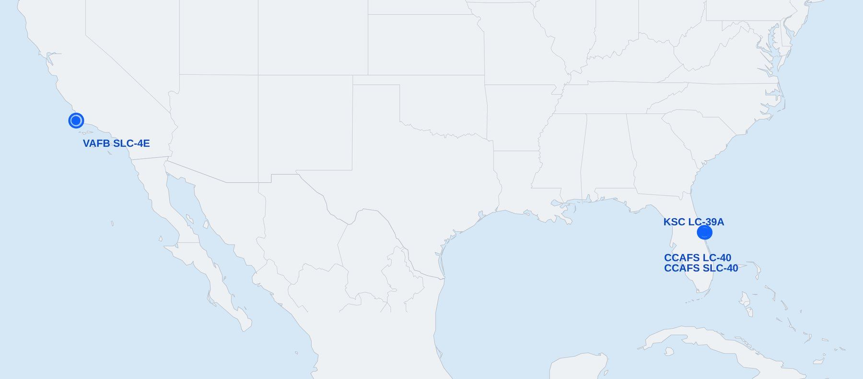
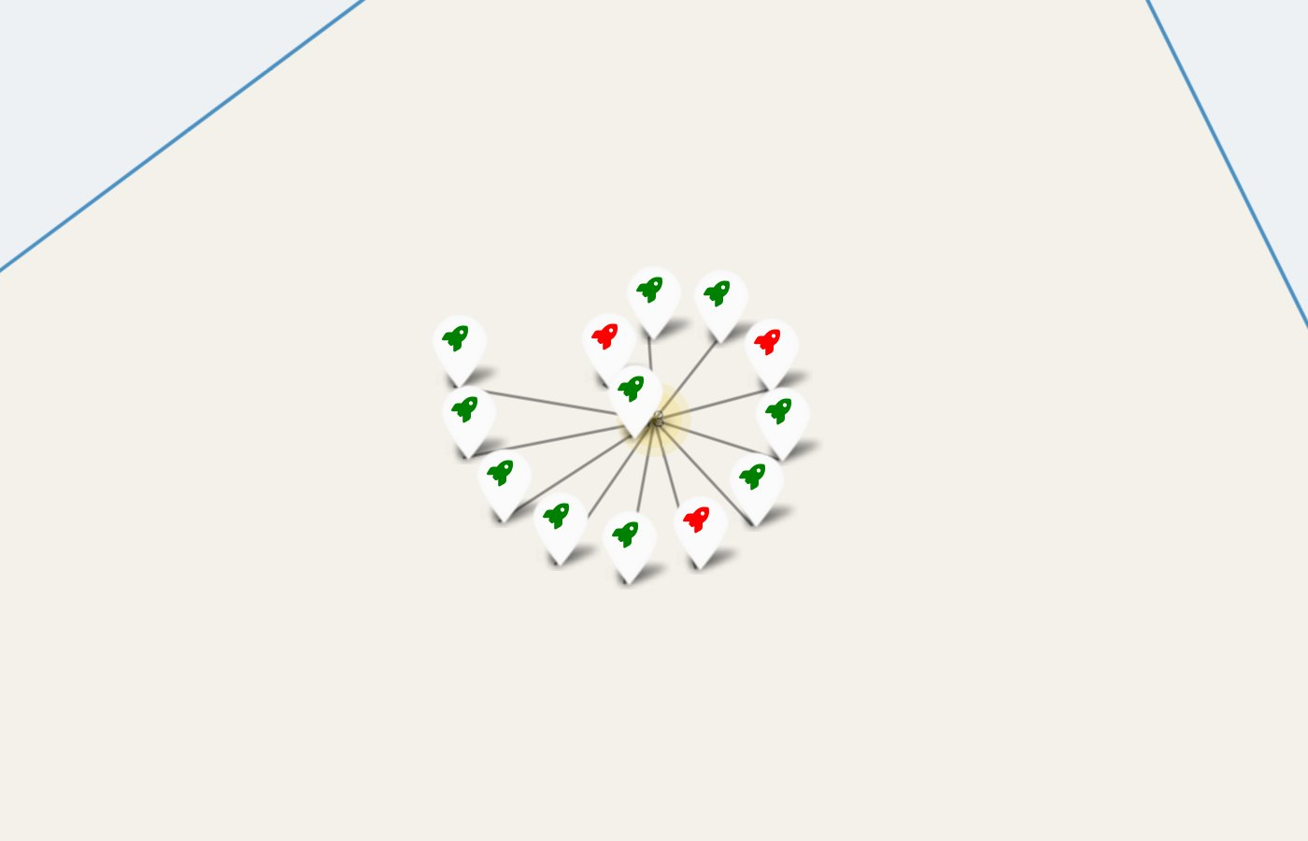
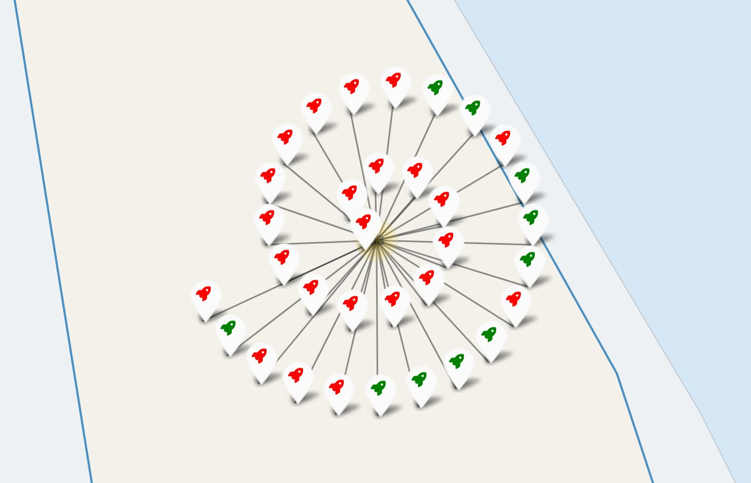
Folium Map Results: Launch Sites and Colour-Labelled Outcomes
All 4 launch-site markers
KSC LC-39A: 10 green / 13
CCAFS LC-40 + SLC-40: 10 green / 33
All launch sites are on the coast (Florida ~28.5°N, California ~34.6°N), so rockets fly over the ocean and drone-ship recovery is possible
Green = landed, red = failed. Success ratio: KSC LC-39A 77%, CCAFS SLC-40 43%, VAFB SLC-4E 40%, CCAFS LC-40 27%
Key insight KSC LC-39A has the best success ratio; CCAFS LC-40 has the most failures because it hosted the early learning-phase flights.

Slide 21
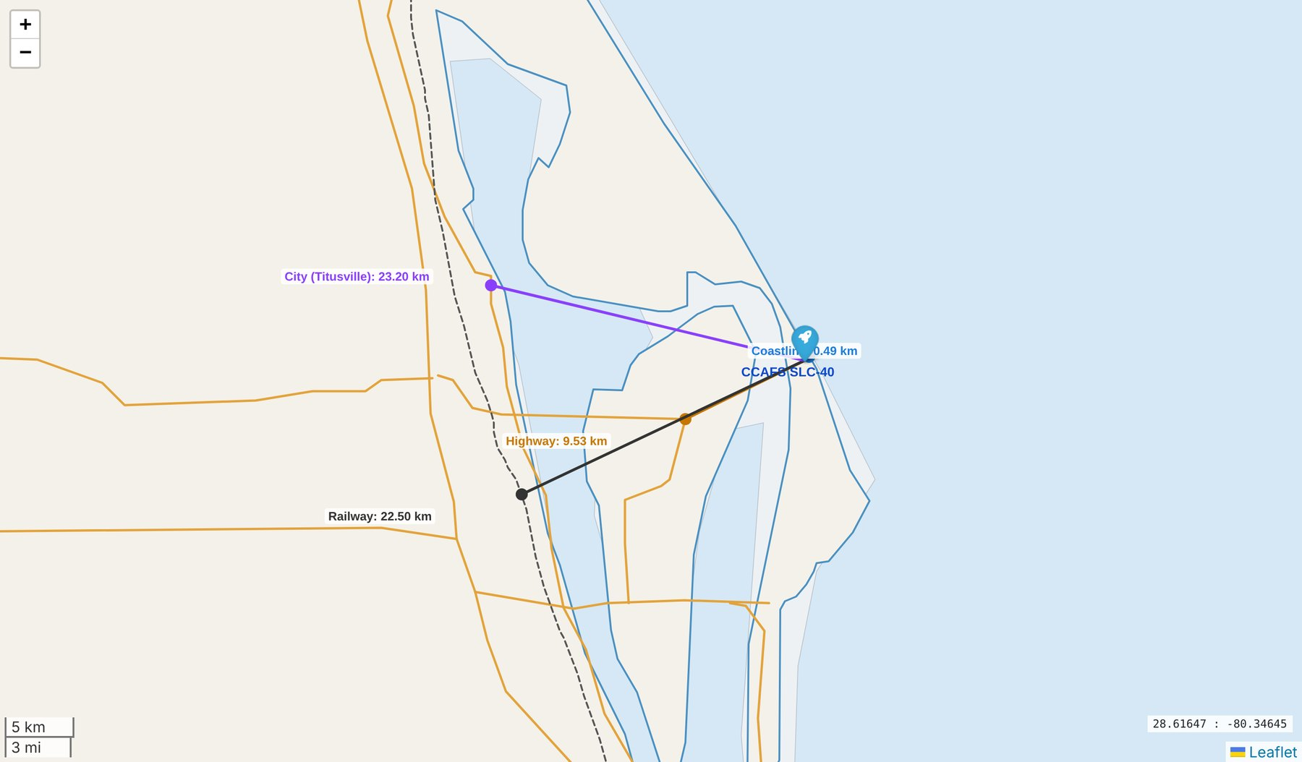
Folium Map Results: Proximity of CCAFS SLC-40 to Coast, Roads, Rail and City
Feature | Distance
Coastline | 0.49 km
Highway (SR-405) | 9.53 km
Railway (mainline) | 22.50 km
City (Titusville) | 23.20 km
Very close to the coast: safe abort and splash-down over the ocean
Kept away from cities, highways and mainline rail for public safety
On-base roads and rail spurs are not in the 10 m basemap, so real access is closer

Slide 22
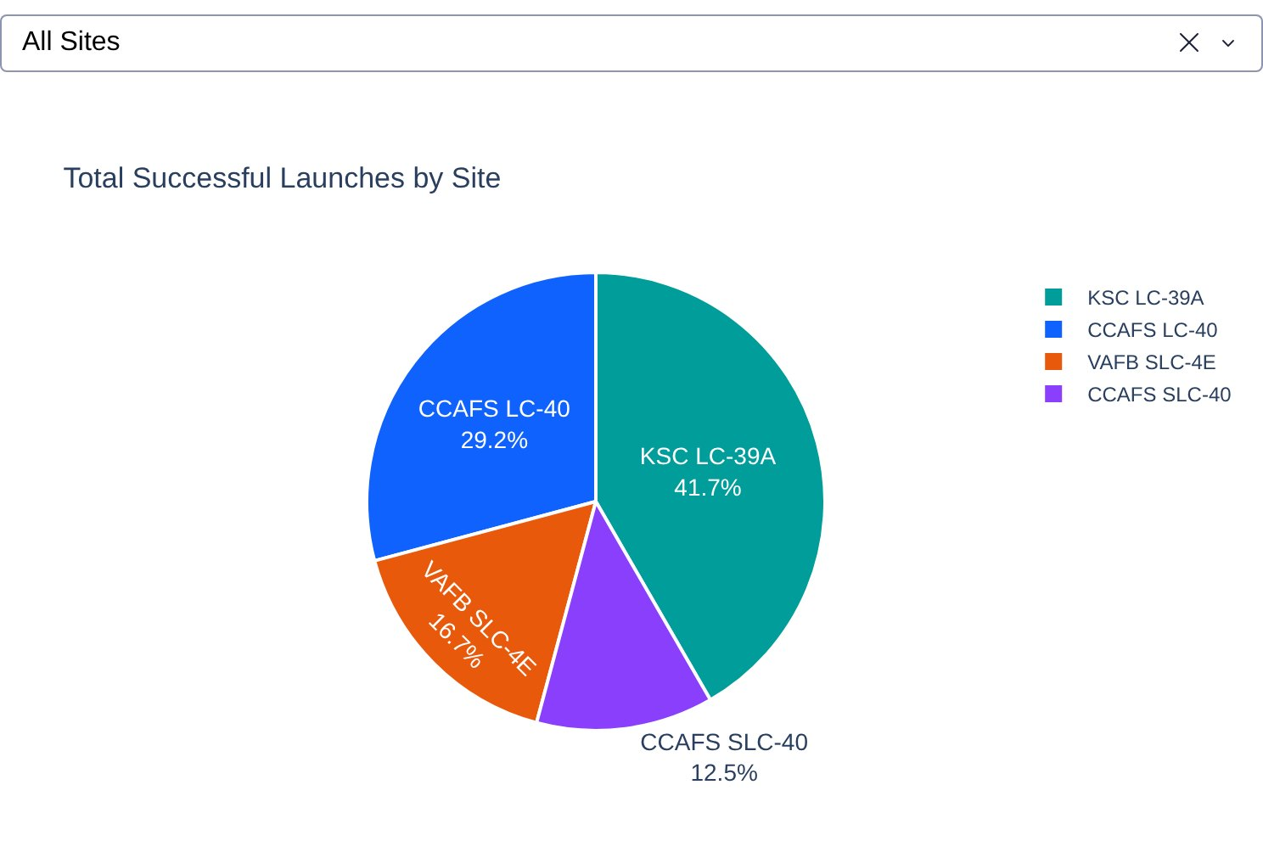
Plotly Dash Results: Launch Success Count for All Sites (Pie Chart)
Dropdown = All Sites; the pie chart shows each site's share of all successful launches
KSC LC-39A 41.7%
CCAFS LC-40 29.2%
VAFB SLC-4E 16.7%
CCAFS SLC-40 12.5%
Key insight KSC LC-39A has the most successful launches of all sites, even though CCAFS LC-40 flew more launches (26 vs. 13).

Slide 23
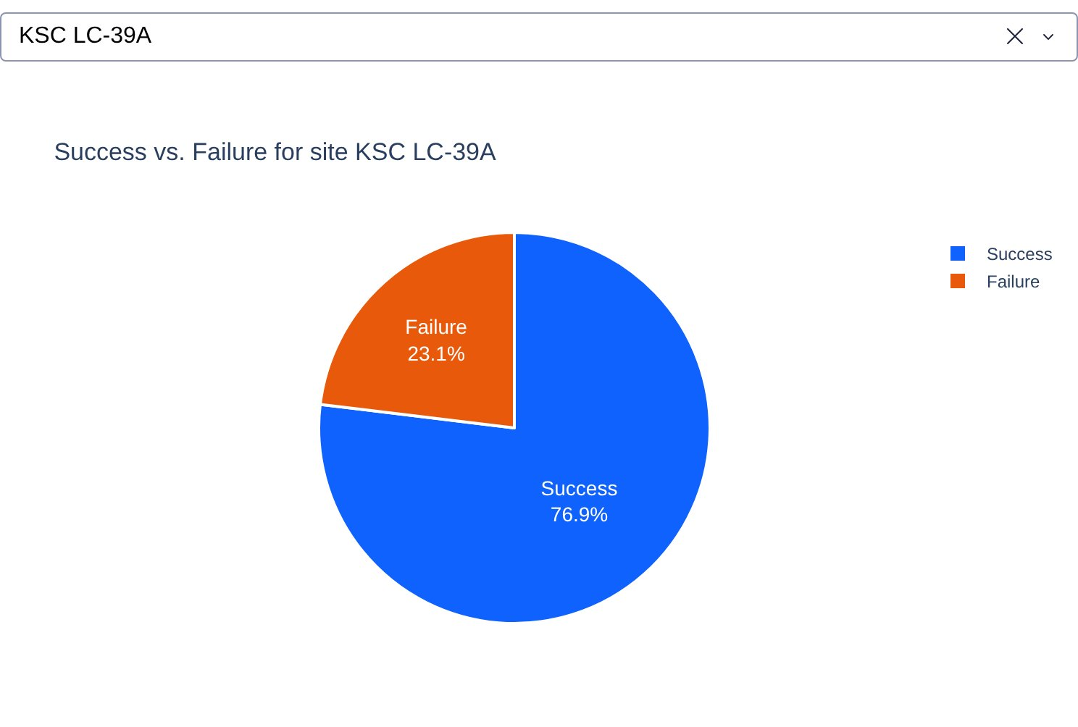
Plotly Dash Results: KSC LC-39A, the Site with the Highest Success Ratio
76.9%
success ratio at KSC LC-39A
(10 of 13 launches)
Pie chart for the selected site: 76.9% success vs. 23.1% failure (3 launches)
Other sites: CCAFS SLC-40 42.9%, VAFB SLC-4E 40.0%, CCAFS LC-40 26.9%
Key insight KSC LC-39A leads both in share of successes and in success ratio; it was used only after the early learning phase.

Slide 24
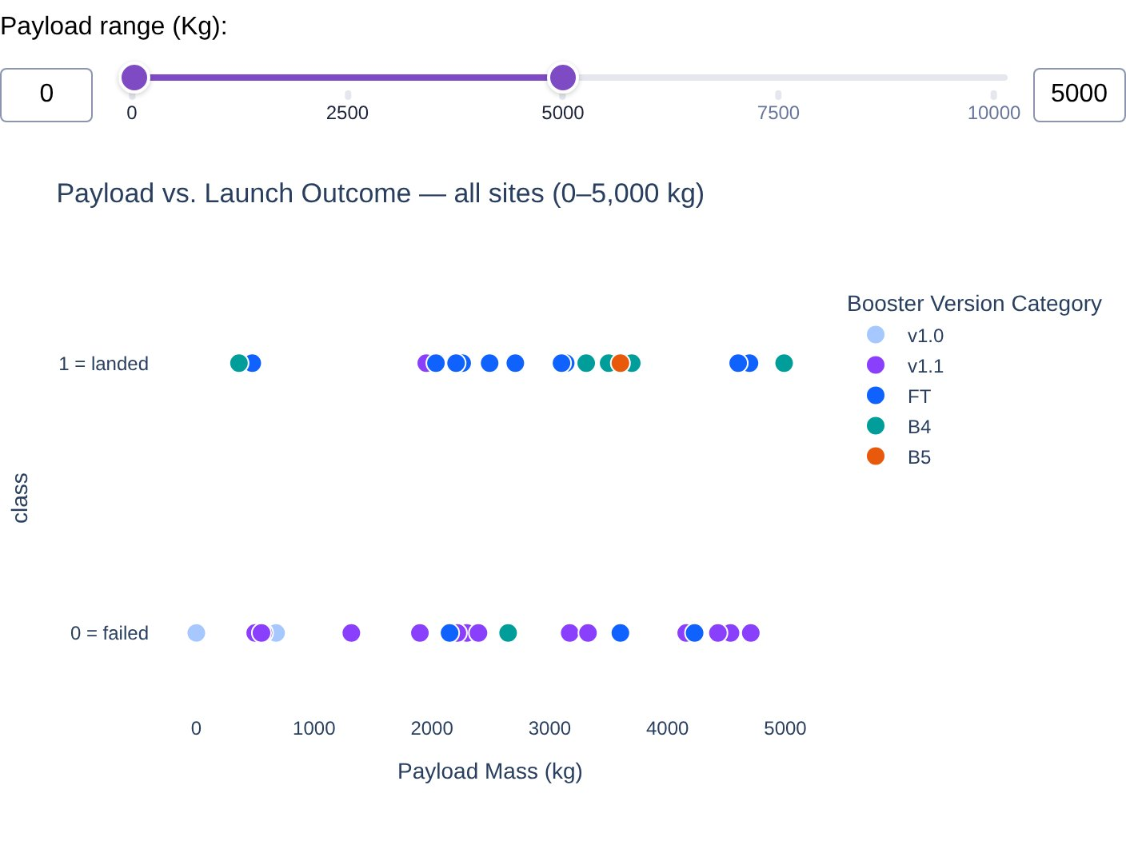
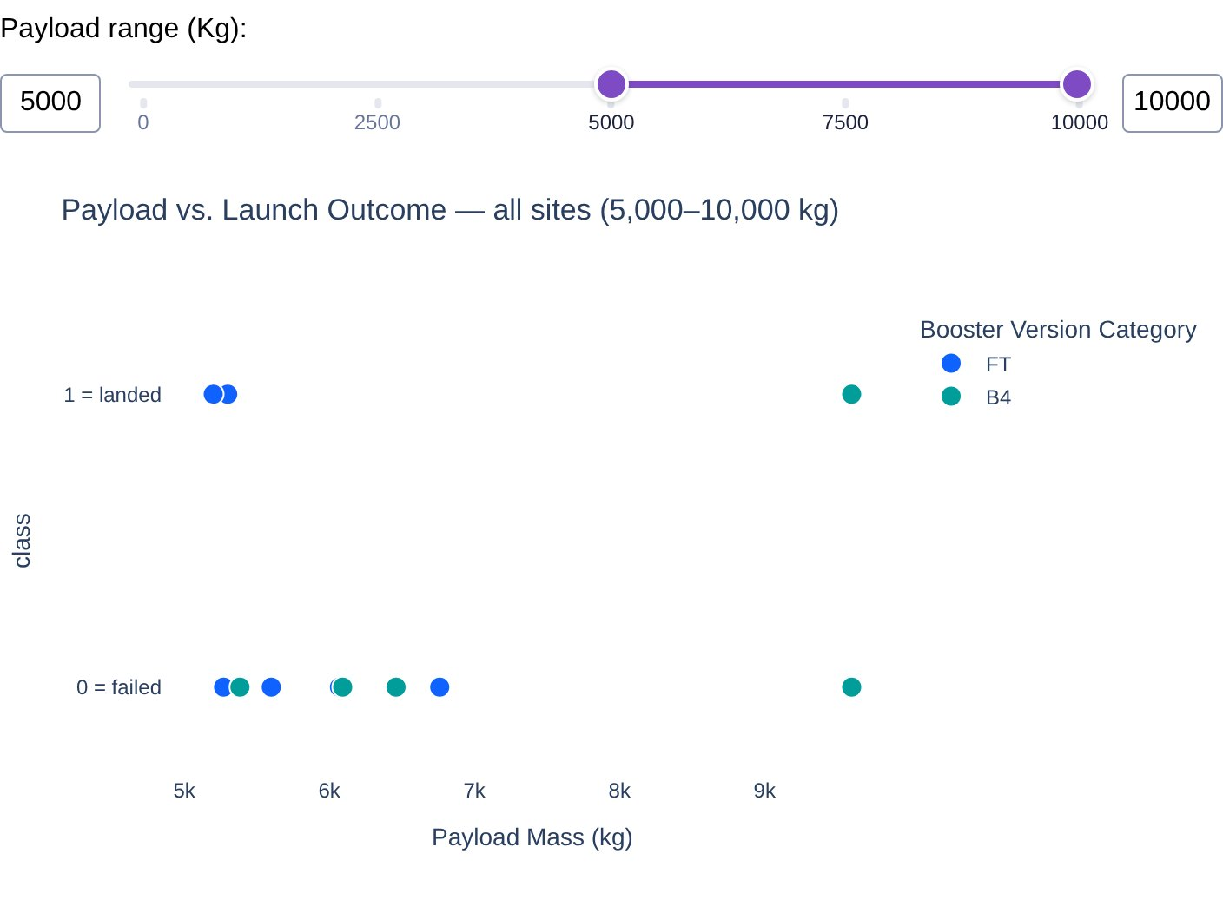
Plotly Dash Results: Payload vs. Launch Outcome for All Sites (Range Slider)
Slider 0–5,000 kg: 19 of 42 landed (45%)
Slider 5,000–10,000 kg: 3 of 11 landed (27%)
Key insight 2,000–4,000 kg has the highest success rate (62%); 6,000–8,000 kg never landed. Booster FT (67%) and B4 (55%) perform best; v1.0 (0%) and v1.1 (7%) almost never landed.

Slide 25
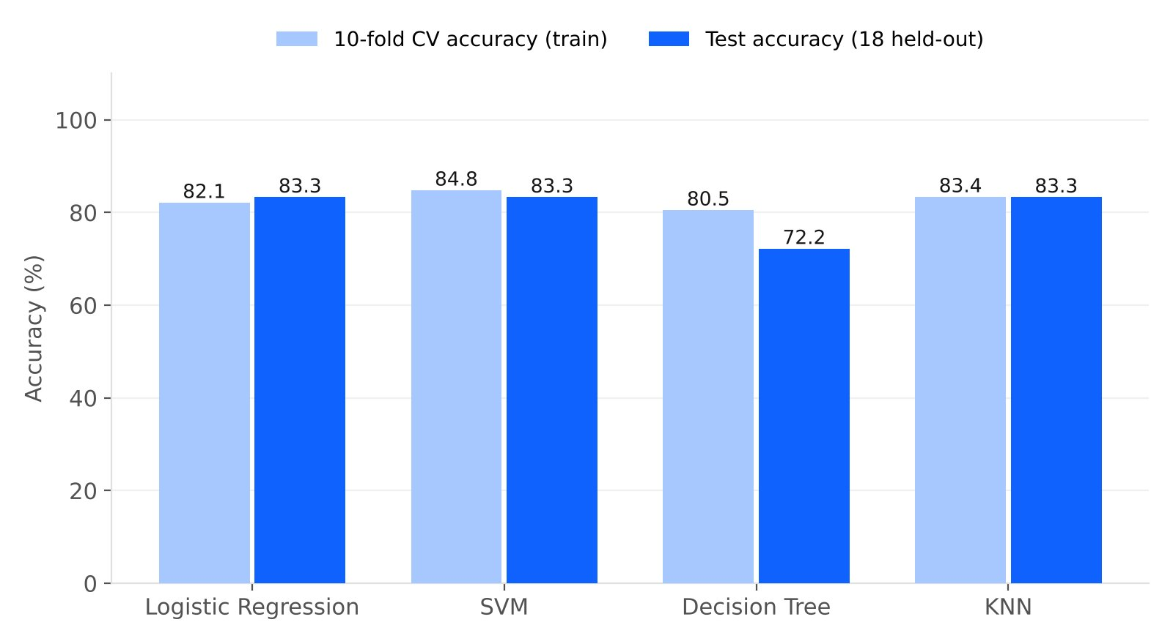
Predictive Analysis Results: Classification Accuracy
Model | CV acc. | Test acc. | F1
Logistic Regression | 82.1% | 83.3% | 0.89
SVM | 84.8% | 83.3% | 0.89
Decision Tree | 80.5% | 72.2% | 0.80
KNN | 83.4% | 83.3% | 0.89
LogReg, SVM and KNN tie at 83.3% test accuracy (15 of 18); Decision Tree 72.2%
Highest accuracy: SVM, with the best CV score (84.8%)
Repeated CV: SVM 84.8% ± 7.3% stays best (baseline 66.7%)
Key insight Best model: SVM (sigmoid kernel, C = 1, γ = 0.032): 83.3% test accuracy and 84.8% CV accuracy.

Slide 26
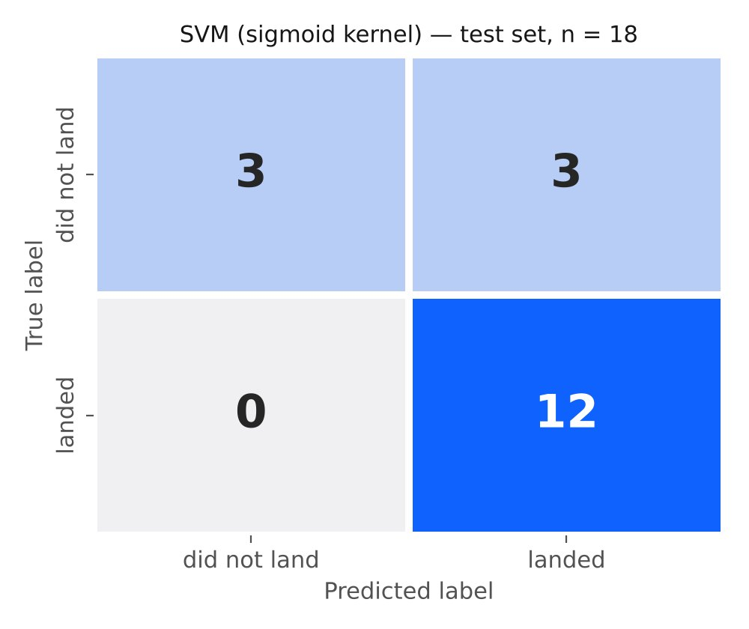
Predictive Analysis Results: Confusion Matrix of the Best Model (SVM)
12
3
3
true positives
true negatives
false positives
Recall = 100%: every real landing is predicted correctly (0 false negatives)
Precision = 80%: the only error is predicting a landing for 3 boosters that were lost
LogReg and KNN give the same matrix; the Decision Tree also misses 2 landings
Key insight False positives are the costly error for a bidder: they make SpaceX look cheaper than it is.

Slide 27
Conclusions
Experience drives success
Hardware beats geography
Landing success rose from 0% (2010–13) to 84–90% (2019–20); flights 61–90 landed 83% of the time.
Legs, grid fins, Block 5 and booster reuse have the strongest associations with landing.
Sites & orbits
Payload is secondary
KSC LC-39A has the best success ratio (77%). ES-L1, GEO, HEO, SSO were 100% but rare; GTO is hardest (52%).
2,000–4,000 kg is the sweet spot; heavy LEO/VLEO payloads land well, GTO is uncertain at any mass.
Prediction works
Next steps
SVM is the best model: 83.3% test and 84.8% CV accuracy, with no missed landings.
Add weather and booster-age features, weight recent flights, and retrain on post-2020 launches.

Slide 28
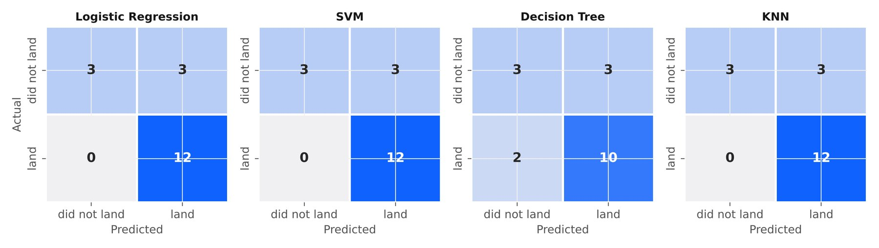
Appendix
Confusion matrices of all 4 models on the 18-launch test set; top features: FlightNumber, PayloadMass, GridFins, ReusedCount
Data: dataset_part_1/2/3.csv, Spacex.csv (101 rows), spacex_launch_geo.csv / spacex_launch_dash.csv (56 rows)
Environment: Python 3, pandas, scikit-learn, seaborn, folium, dash/plotly, SQLite; split random_state = 2
Folium basemap: Natural Earth 10 m layers; distances are Haversine to the nearest mapped feature
GitHub repository (all notebooks + Dash app): https://github.com/martimramos/ibmds

